Slide 1
Carbon Monitoring and Projection: Permanent Forest Loss
Quan Shen

Slide 2
Outline
Background & Goal
Data
Method
Result
Discussion

Slide 3
Background and Goal
Monitor carbon stock and calculate carbon budget for U.S. Climate Alliance
The Ecosystem Demography (ED) model assumes no new permanent loss
Improve the accuracy of the ED model results by incorporating permanent forest loss
Project permanent forest loss

Slide 4
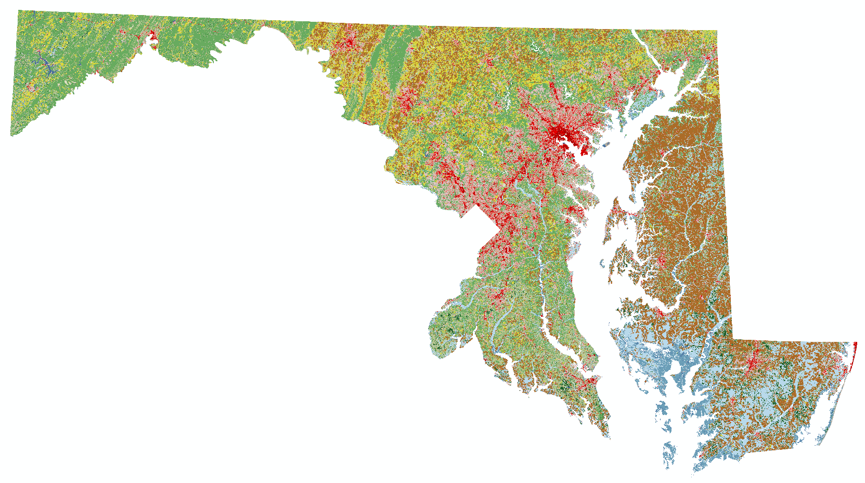
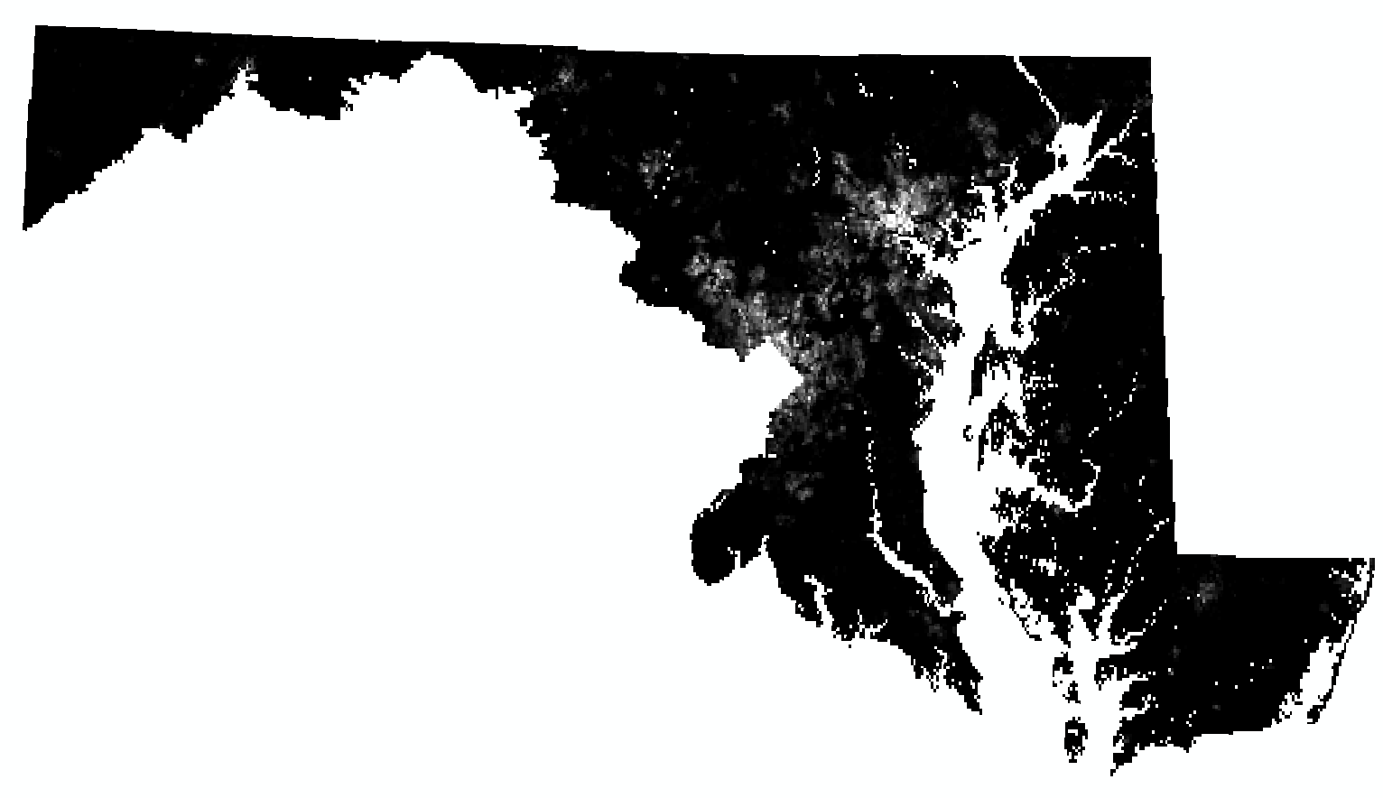
Data
Land cover datasets from National Land Cover Database (NLCD)
Time period: 2004, 2006, 2008, 2011, 2013, 2016
Preprocess: clip and reproject
Population density datasets from NASA
Time period: 2005, 2010, 2015
Preprocess: clip, reproject, resample

Slide 5
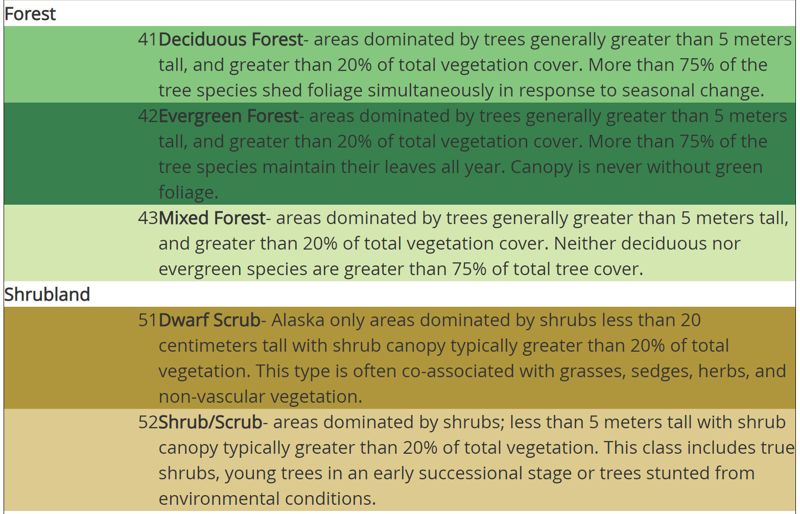
NLCD Land Cover Data Legend
Water → 10
Developed → 20
Barren → 30
Forest → 40
Shrubland → 50
Herbaceous → 70
Cultivated → 80
Wetland → 90
https://www.mrlc.gov/data/legends/national-land-cover-database-2016-nlcd2016-legend

Slide 6
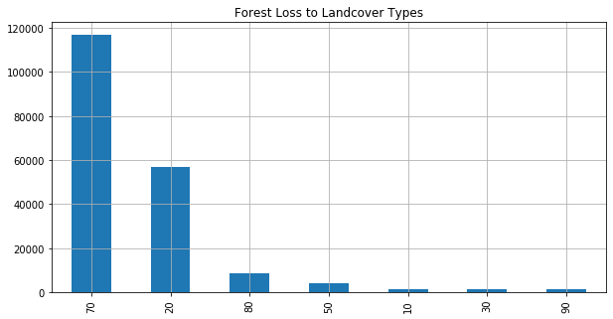
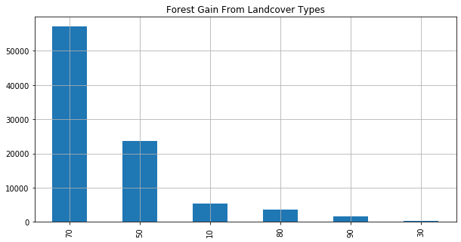
Method
Identify the permanent loss

Slide 7

Method
Create loss datasets
2004 2006 2008 2011 2013 2016
Loss 2006 Loss 2008 Loss 2011 Loss 2013 Loss 2016

Slide 8
Method
Non-spatial and spatial regression
Y = forest loss
X = land cover (previous), population density
 | OLS | Lag | Error
Intercept | 0 | -0.018 | -0.082
Land Cover | -0.051 | -0.009 | -0.0105
Population Density | 0.274 | 0.033 | 0.064
Rho |  | 0.890
Lambda |  |  | 0.802
R-squared | 0.0783 | 0.6147 | 0.0783

Slide 9
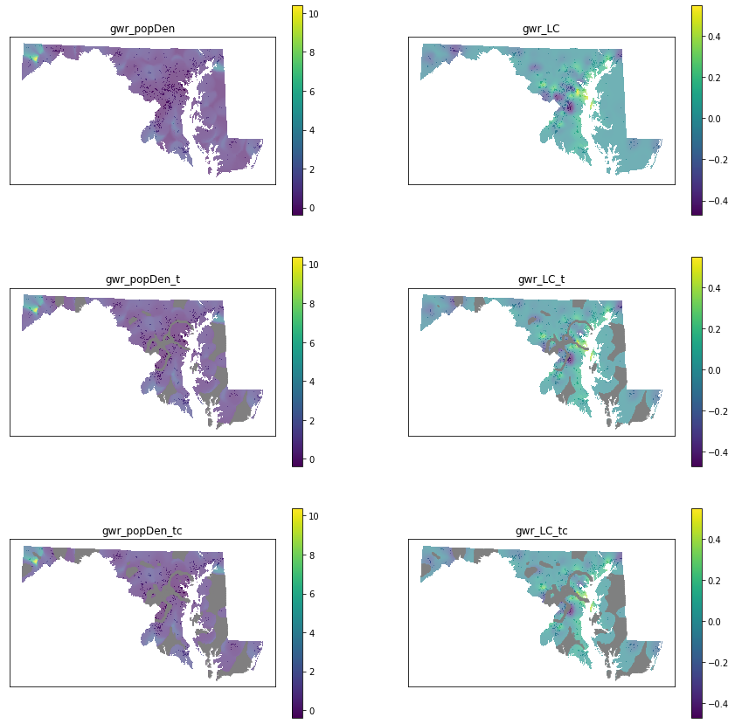
Method
GWR
R-squared = 0.400

Slide 10
Non-forest loss < 20000; n = 1000
Binned landcover
Non-forest loss = 20000; n = 1000
Non-forest loss = 2000; n = 100
Non-forest loss < 20000; n = 1000
9 neighbors
Landcover
Non-forest loss = 20000; n = 1000
Non-forest loss = 2000; n = 100
Non-forest loss < 20000; n = 1000
Landcover w/ population density
Non-forest loss = 20000; n = 1000
Non-forest loss = 2000; n = 100

Slide 11
Landcover
Non-forest loss = 20000; n = 1000
Non-forest loss = 2000; n = 100
25 neighbors
Landcover w/ population density
Non-forest loss = 20000; n = 1000
Non-forest loss = 2000; n = 100

Slide 12
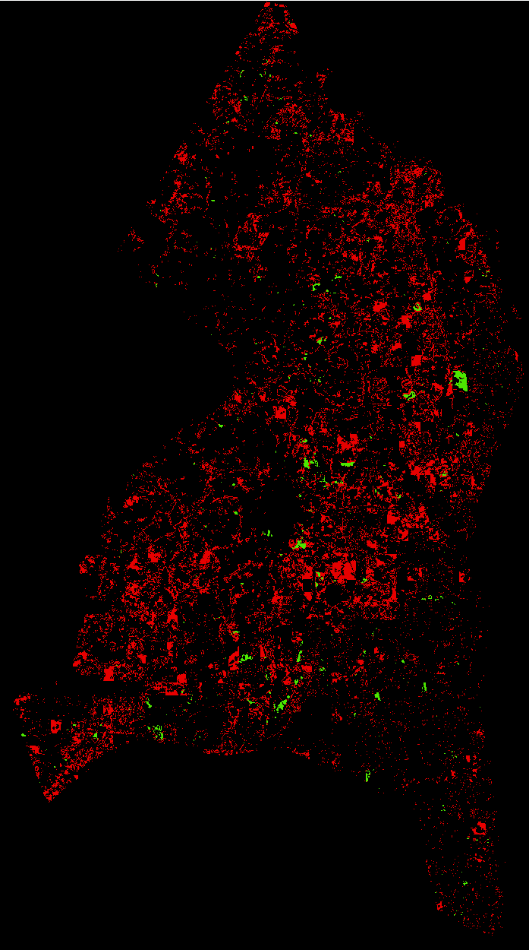
Method
Random forest: 3 by 3 window; on Prince George’s County
Training: Loss 2006, 2011, 2016; NLCD 2004, 2008, 2013; (Pop Den 2005, 2010, 2015)
Test: NLCD 2016; (Pop Den 2015)
Reference: Global Forest Watch (GFW) loss year 2017-2019
 | Binned |  |  | Original |  |  | Original w/ Pop Density
 | <20000, n=1000 | >20000, n=1000 | >20000, n=100 | <20000, n=1000 | >20000, n=1000 | >20000, n=100 | <20000, n=1000 | >20000, n=1000 | >20000, n=100
Overlap | 940 | 297 | 269 | 1207 | 700 | 643 | 1079 | 1616 | 1775
Projected | 6159 | 3573 | 3509 | 6580 | 4748 | 4476 | 6003 | 8056 | 8346
GFW | 7617 | 7617 | 7617 | 7617 | 7617 | 7617 | 7617 | 7617 | 7617
User’s accuracy | 15.26% | 8.3% | 7.67% | 18.34% | 14.74% | 14.36% | 17.98% | 20.06% | 21.27%
Producer’s accuracy | 12.3% | 3.9% | 3.53% | 15.8% | 9.2% | 8.4% | 14.16% | 21.2% | 23.3%

Slide 13
Method
5 by 5 window
 | Original |  | Original w/ Pop Density
 | >20000, n=1000 | >20000, n=100 | >20000, n=1000 | >20000, n=100
Overlap | 700 | 698 | 35 | 35
Projected | 4581 | 4468 | 813 | 733
GFW | 7617 | 7617 | 7617 | 7617
User’s accuracy | 15.28% | 15.62% | 4.3% | 4.77%
Producer’s accuracy | 9.2% | 9.16% | 0.46% | 0.46%

Slide 14
Discussion
 | Loss 06 & GFW 05-06 | Loss 11 & GFW 09-11 | Loss 16 & GFW 14-16
Overlap | 742 | 568 | 756
NLCD loss | 806 | 2363 | 795
GFW | 11998 | 4255 | 5809
User’s accuracy | 92.05% | 24.04% | 95.1%
Producer’s accuracy | 6.18% | 13.3% | 13%
GFW is not a good reference data

Slide 15
Discussion
Spatial lag model performs better than OLS and spatial error models, indicating forest loss has a positive influence on its neighbors
GFW shows that population density has a positive influence, and the previous land cover has both positive and negative influences
More samples and more trees in the random forest model don’t necessarily increase the accuracies
More spatial variables might increase the accuracies
Look forward to the new NLCD Land cover dataset

